Slide 1

Terraform Code

Slide 2
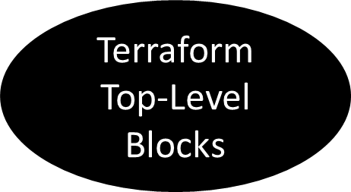

Terraform Block
Input Variables Block
Data Sources Block
Providers Block
Output Values Block
Modules Block
Resources Block
Local Values Block
Fundamental Blocks
Variable Blocks
Calling / Referencing Blocks

Slide 3
Terraform Basic Blocks
Terraform Block
Provider Block
Resource Block
Special block used to configure
some behaviors
HEART of Terraform
Each Resource Block describes one
or more Infrastructure Objects
Specifying a required Terraform
CLI Version
Terraform relies on providers to
interact with Remote Systems
Resource Syntax:
How to declare Resources?
Specifying Provider Requirements
& Versions
Declare providers for Terraform to
install providers & use them
Resource Behavior: How Terraform
handles resource declarations?
Configuring a Backend
Terraform(Terrafom State)
Provider configurations belong to
Root Module
Provisioners: We can configure Resource post-creation actions
www.apexgloballearning.com

Slide 4
Terraform Block

Slide 5
Terraform Block
Each terraform block can contain a number of settings related to Terraform's behavior.
Within a terraform block, only constant values can be used; arguments may not refer to named objects such as resources, input variables, etc, and may not use any of the Terraform language built-in functions.

Slide 6
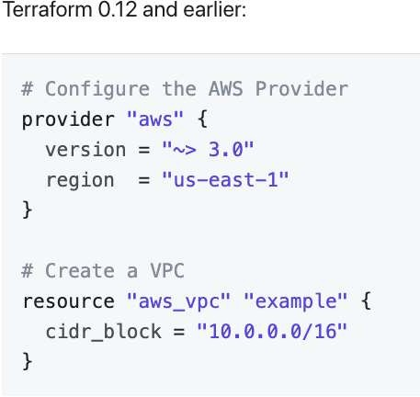
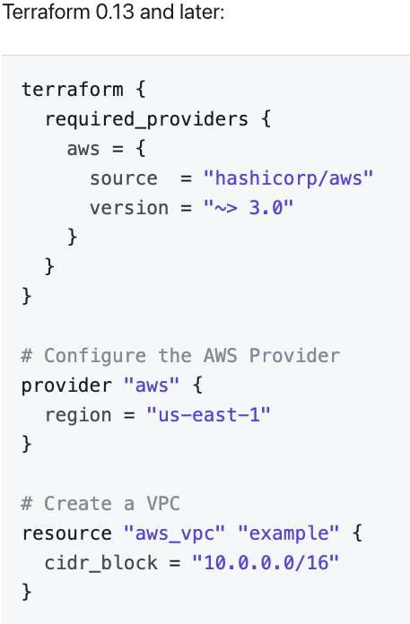
Terraform Block from 0.13 onwards

Slide 7
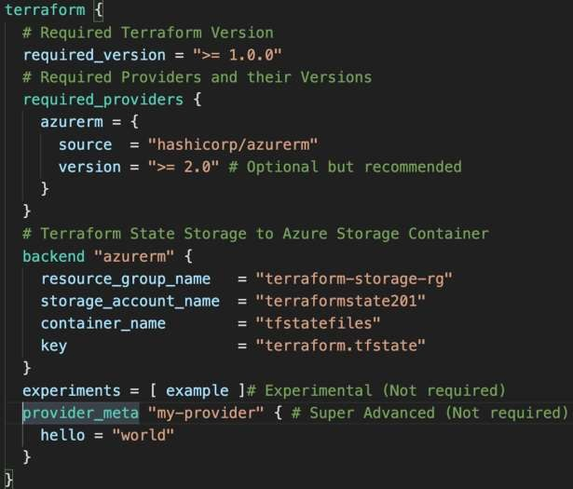
Block
Required Terraform Version
Provider Requirements
Terraform
Block
Terraform Backend
Experimental Language
Features
Passing Metadata to
Providers

Slide 8
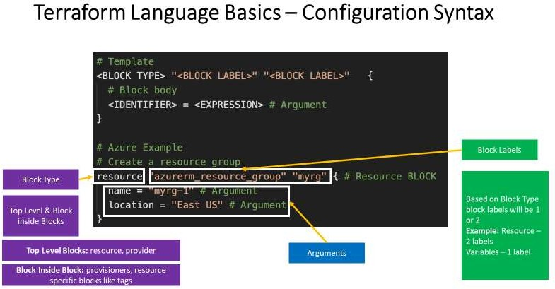
Terraform Language Basics

Slide 9
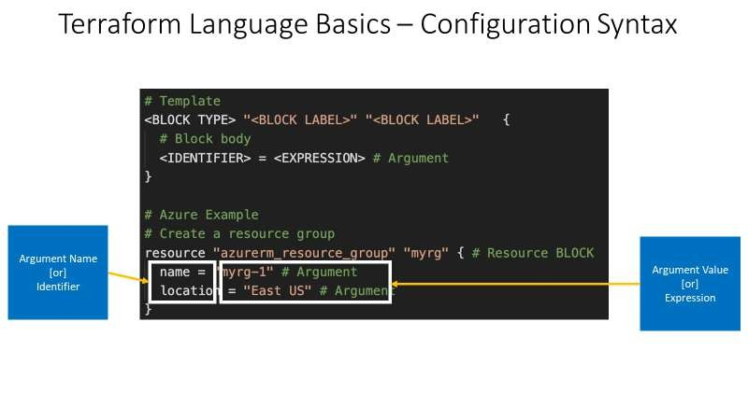
Terraform Language Basics

Slide 10
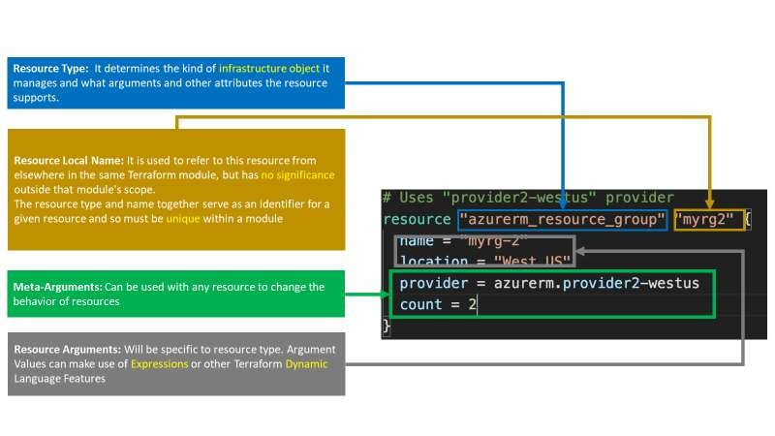
Resource Syntax

Slide 11
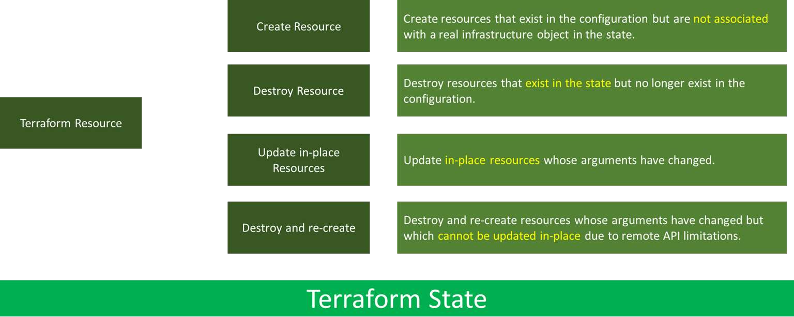
Resource Behavior

Slide 12
Terraform HCL - Syntax
Single line comments start with # or //
Multi-line comments are wrapped in /* and */
Values are assigned with the syntax key = value
The value can be any primitive: a string, number, boolean, object, or list.
Strings are double-quoted and can contain any UTF-8 characters. Example:
"Hello, World“
Boolean values: true, false
Arrays can be made by wrapping it in []. Example: ["foo", "bar", 42]

Slide 13
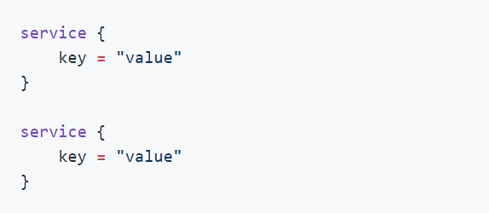
Terraform HCL - Syntax
Lists of objects can be created with repeated blocks, using this structure

Slide 14
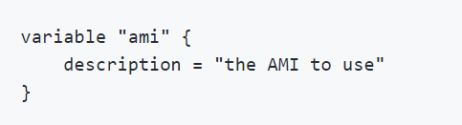
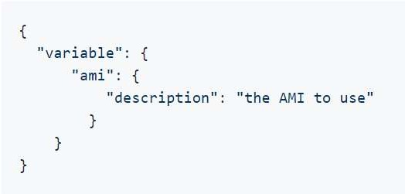
Terraform HCL - Syntax
Objects and nested objects are created using the structure shown
below:
JSO
N

Slide 15
Terraform Variables

Slide 16
Variables in Terraform
Variable a symbolic name associated with a value and whose associated value may be changed
Variables in Terraform are a great way to define centrally controlled reusable values. The information in Terraform variables is saved independently from the deployment plans, which makes the values easy to read and edit from a single file.

Slide 17
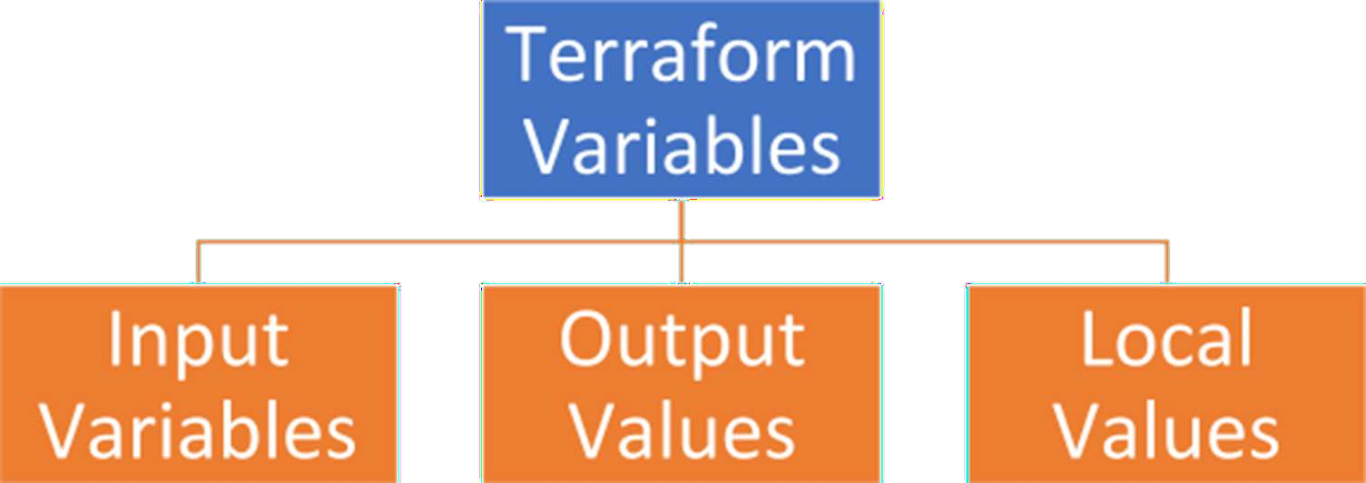

Slide 18
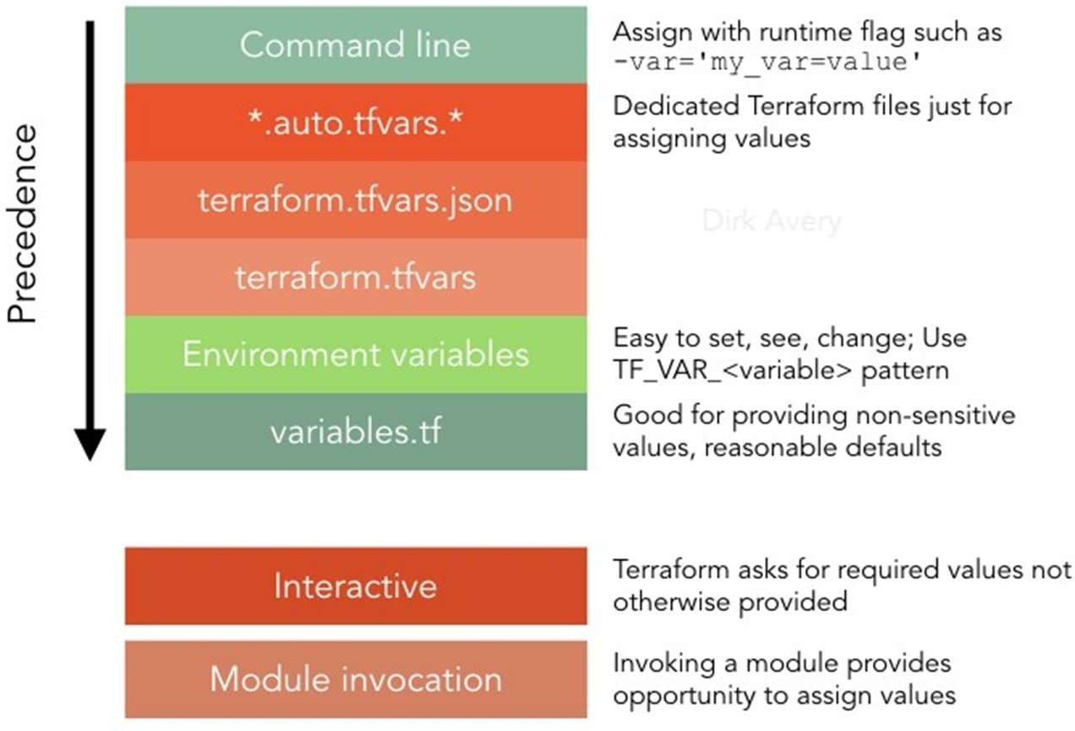

Slide 19
Input Variables
Input variables serve as parameters for a Terraform module/Terrform code, allowing aspects of the module/Terraform code to be customized without altering the module's own source code, and allowing modules to be shared between different configurations.
When you declare variables in the root module of your configuration, you can set their values using CLI options and environment variables.
When you declare them in child modules, the calling module should pass values in the module block.

Slide 20
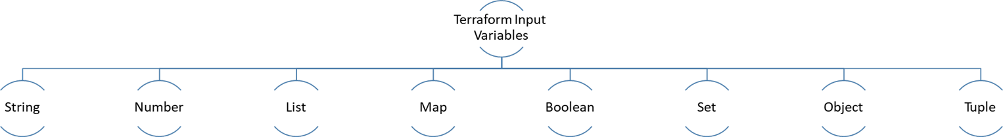
Terraform Input Variable Types

Slide 21
Terraform Simple Variable types
String
variable “a-string”{
type = string
}
Number (Integer)
variable “it is an integer”{
type = number
}
Bool (it is Boolean
variable “true or false”{
type = bool
}

Slide 22
Terraform complex types
List(type)
Set(type)
Map(type)
Object({<ATTR NAME> =<TYPE>, …..})
TUPLE([<TYPE>, …..])

Slide 23
List
List: [0,1,3]
Lists always return values in Ordered format.
Example: [0,1,3] will not return [3,0,1]

Slide 24
Map
Map { key: value}
variable “mymap”{ type = map(string) default = {
mykey = “my value”
}
}

Slide 25
Set
A “set” is like a list, but it doesn’t keep the order you put in it and will return only unique values.
Example: [1,1,2,2] will return [1,2] only

Slide 26
Tuple
A tuple is like a list, but each element can have a different type.
Example: [0, “string”, false]

Slide 27
Object
An Object is like a map, but each element can have a different type.
Example: {
firstname = “john”
housenumber = 10
}
// It is a string
//it is a number

Slide 28
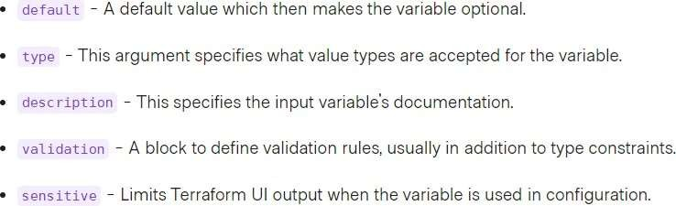
Terraform Input Variable
Variable blocks have 5 optional arguments.
We recommend setting a description and type for all variables, and setting a default value when practic
If you do not set a default value for a variable, you must assign a value before Terraform
can apply the configuration. Terraform does not support unassigned variables.

Slide 29
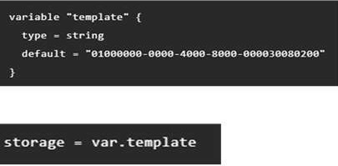
Terraform Variable Type: String

Slide 30
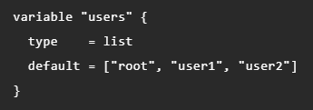

Terraform Variable Type: List

Slide 31
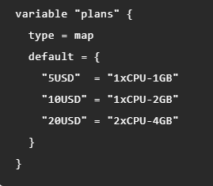

Terraform Variable Type: Map

Slide 32
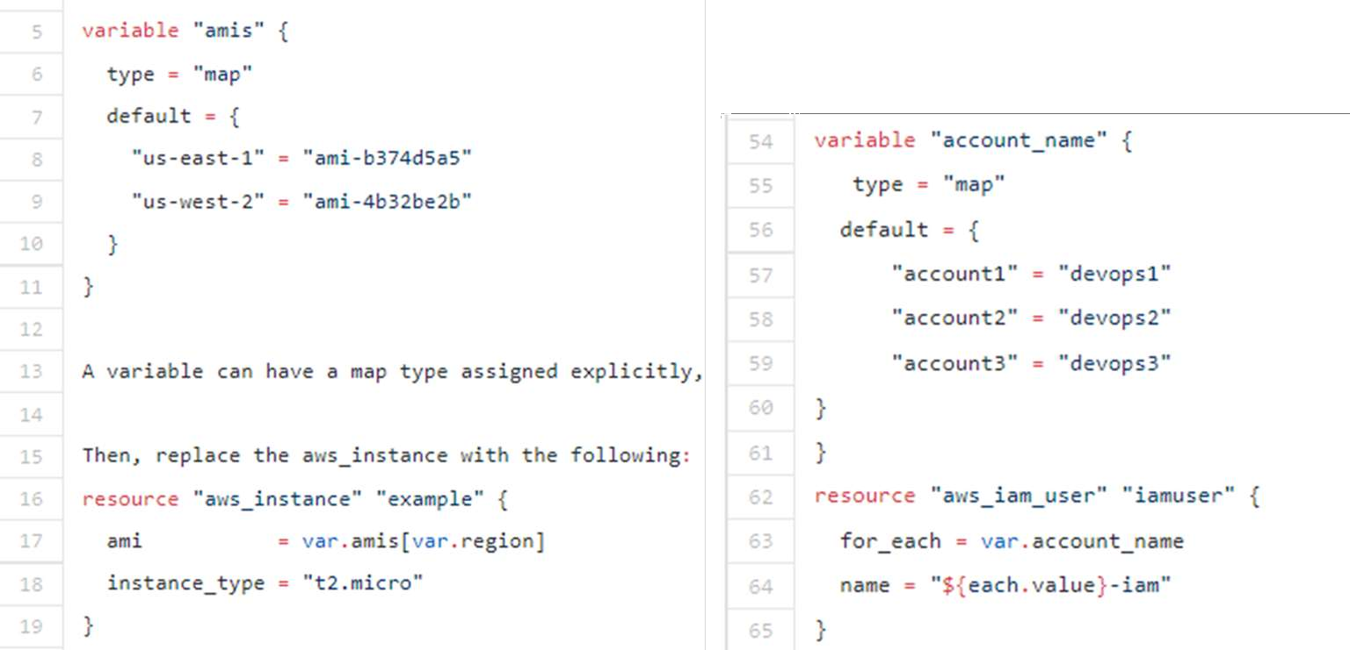
Terraform Variable Type: Map

Slide 33

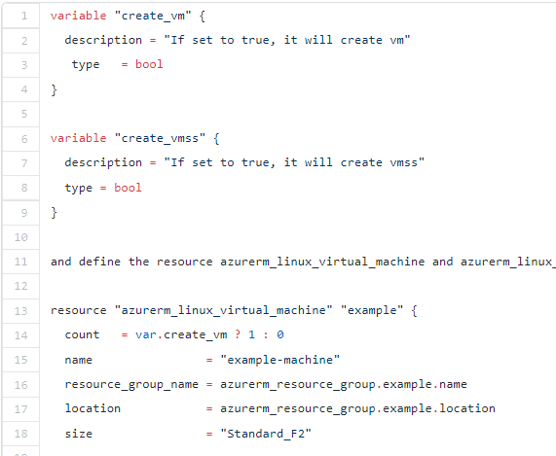


Terraform Variable Type: Bool

Slide 34
Terraform Variable: Output
Terraform will store hundreds or even thousands of attribute values for all the defined resources in our
infrastructure in state file.
An outputted attributes can not only be used for the user reference but it can also act as an input to other resources being created via Terraform. We can use output variables to organize data to be easily queried and shown back to the Terraform user.
Output values are like the return values of a Terraform module, and have several uses:
A child module can use outputs to expose a subset of its resource attributes to a parent module.
A root module can use outputs to print certain values in the CLI output after running terraform
apply.
- When using remote state, root module outputs can be accessed by other
configurations via a terraform_remote_state data source.

Slide 35
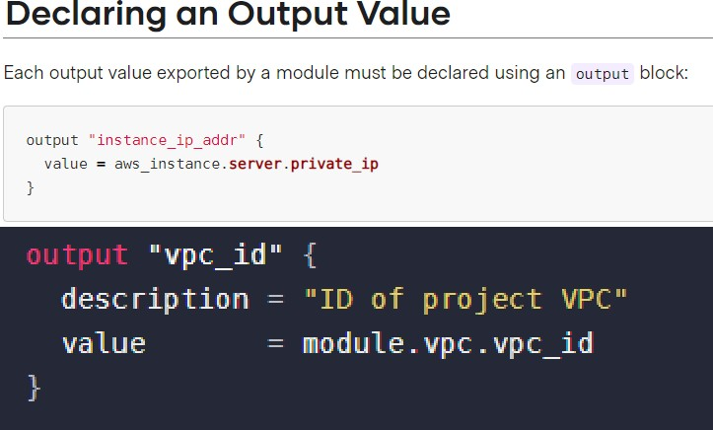
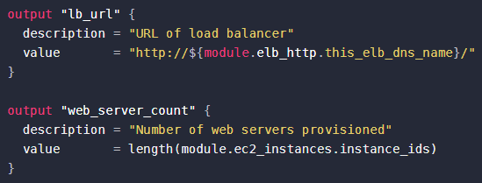
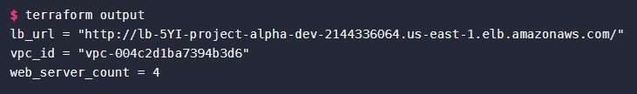
Terraform Variable: Output

Slide 36
Local values in terraform
These are variables that are local to a module. They are defined, assigned, and used in
the same module, and defined in the “locals” block.
Local variables can be declared once and used any number of times in the module. These can be accessed as objects by using the format of "local.Variable_Name".
Unlike variables found in programming languages, Terraform's locals don't change values during or between Terraform runs such as plan, apply, or destroy. You can use locals to give a name to the result of any Terraform expression, and re-use that name throughout your configuration. Unlike input variables, locals are not set directly by users of your configuration.

Slide 37
When To Use Local Values?
Local values can be helpful to avoid repeating the same values or expressions multiple times in a configuration, but if overused they can also make a configuration hard to read by future maintainers by hiding the actual values used.
Use local values only in moderation, in situations where a single value or result is used in many places and that value is likely to be changed in future. The ability to easily change the value in a central place is the key advantage of local values.
Each locals block can have as many locals as needed, and there can be any number of locals blocks within a module. The names given for the items in the local block must be unique throughout a module. The given value can be any expression that is valid within the current module.
The expression of a local value can refer to other locals, but as usual reference cycles are not allowed. That is, a local cannot refer to itself or to a variable that refers (directly or indirectly) back to it.
www.apexgloballearning.com

Slide 38
Resource Metadata

Slide 39
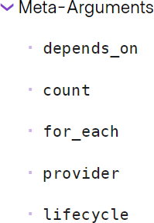

Slide 40
Resource Meta Arg: depends_on
Use the depends_on meta-argument to handle hidden resource or module dependencies that Terraform can't automatically infer.
Explicitly specifying a dependency is only necessary when a resource or module relies on some other resource's behavior but doesn't access any of that resource's data in its arguments.

Slide 41
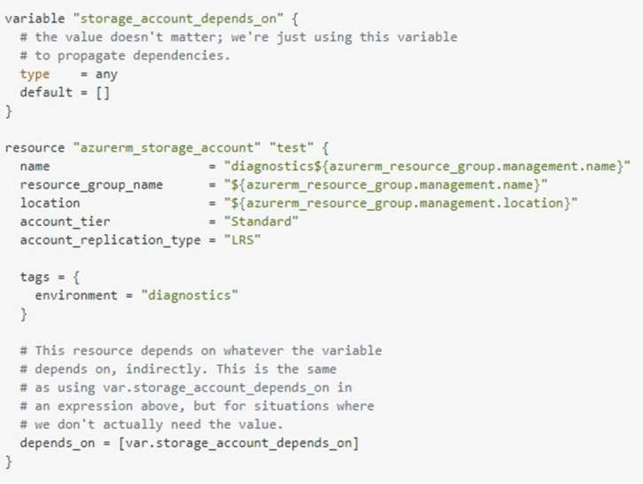
Resource Meta Arg: depends_on –with resource
www.apexgloballearning.com

Slide 42
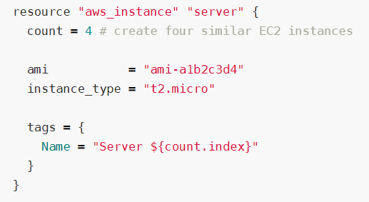
Resource Meta Arg: count
count is a meta-argument defined by the Terraform language. It can be used with modules and with every resource type.
The count meta-argument accepts a whole number, and creates that many instances of the resource or module. Each instance has a distinct infrastructure object associated with it, and each is separately created, updated, or destroyed when the configuration is applied.
www.apexgloballearning.com

Slide 43
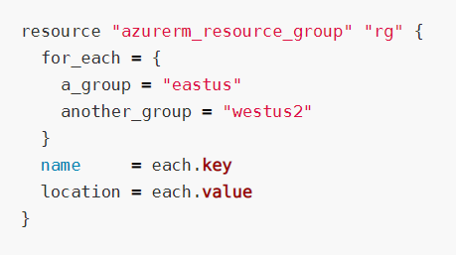
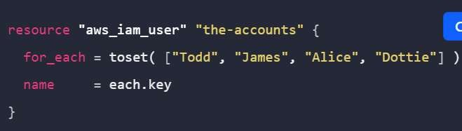
Resource Meta Arg: for_each
for_each is a meta-argument defined by the Terraform language. It can be used with modules and with every resource type.
The for_each meta-argument accepts a map or a set of strings, and creates an instance for each item in that map or set. Each instance has a distinct infrastructure object associated with it, and each is separately created, updated, or destroyed when the configuration is applied.
www.apexgloballearning.com

Slide 44
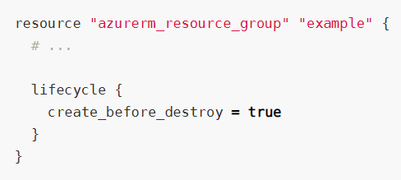
Resource Meta Arg: lifecycle
lifecycle is a nested block that can appear within a resource block. The lifecycle block and its contents are meta-arguments, available for all resource blocks regardless of type.
The following arguments can be used
within a lifecycle block:
create_before_destroy
prevent_destroy
ignore_changes
www.apexgloballearning.com

Slide 45
Thank you!

